Slide 1
Student groups
  News Minute - https://drive.google.com/drive/folders/1Lhwc-otTHJn6owSIp19LbluUiz1N0FVe?usp=sharing
Changes in calendar
  Thanksgiving break week
Please ensure you email me regarding your absence from the class
Zoom link for office hours
I will upload slides from today

Slide 2
CHAPTER 1
Introduction to Services

Slide 3
Chapter Overview
What are services/ Classification frameworks?
Outline the basic differences between goods and services – and the resulting challenges and opportunities for service businesses.
Introduce the expanded marketing mix for services.

Slide 4
SERVICES
SELL
BUY
DROP

Slide 5
Classifying services

Slide 6
NON-OWNERSHIP FRAMEWORK: A key determinant of service offering
Classification 1
Car Repair
Labor, skills, and expertise rentals
Defined space and facility rentals
Access to shared facilities
Access and use of
networks and systems
Rented goods services
Boats, Construction equipment
Theme park
A seat in an airline, a storage container
Banking, Social network

Slide 7

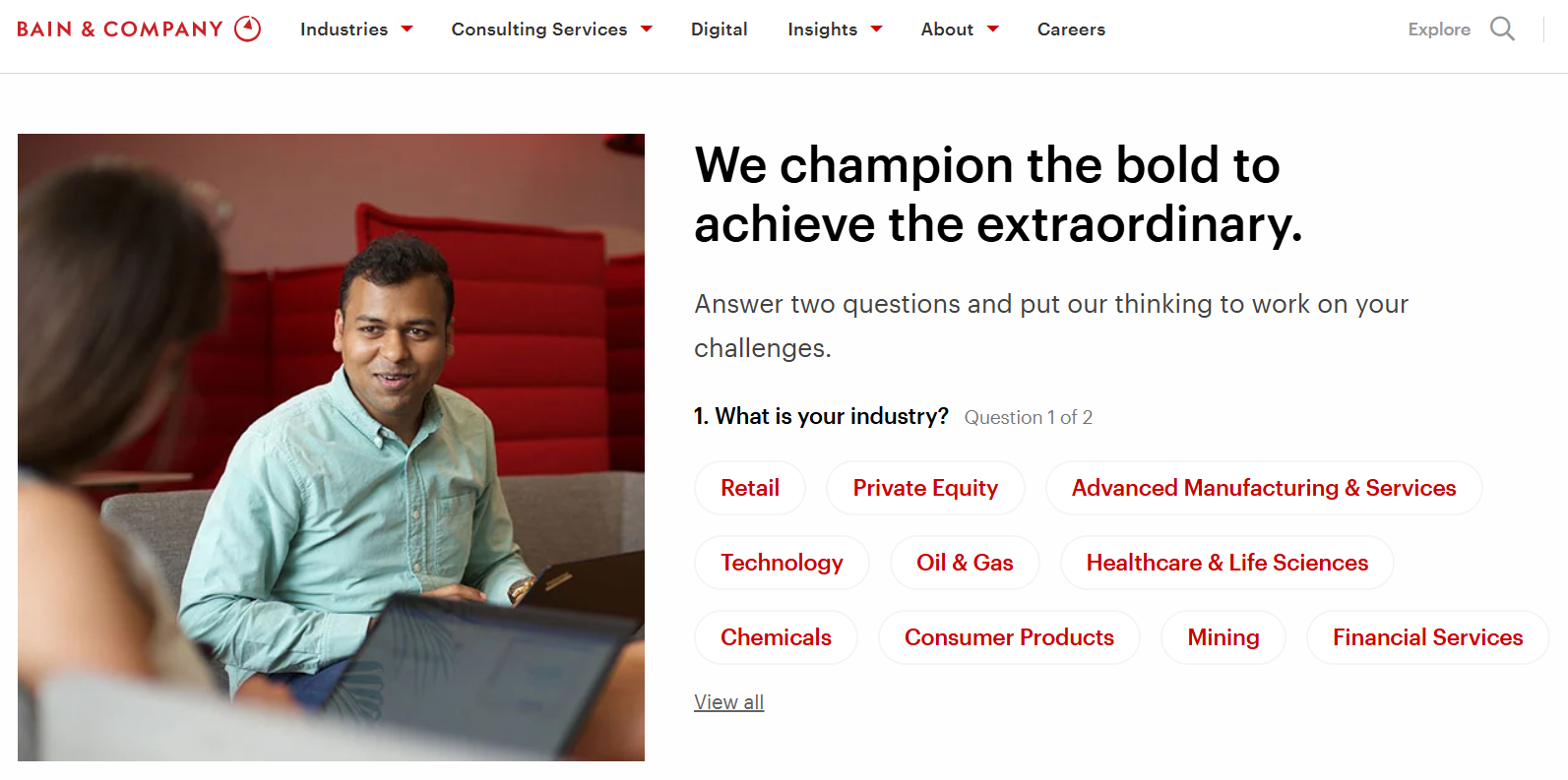
How do services sell expertise?

Slide 8
A process-based framework: Categories of services
Classification 2
Who/ What is the Direct Recipient of the Service?
What is the nature of the service act?
People
Possession
People processing
Possession processing
Tangibility action
Mental stimulus processing
Information
processing
Intangible action

Slide 9

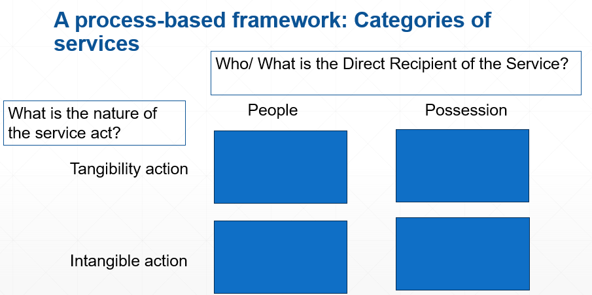

Guess the category?
1
2
3
4

Slide 10
Guess the category?
https://business.michelinman.com/freight-transportation/freight-transportation-services/michelin-fleet-solutions
1
2
3
4

Slide 11

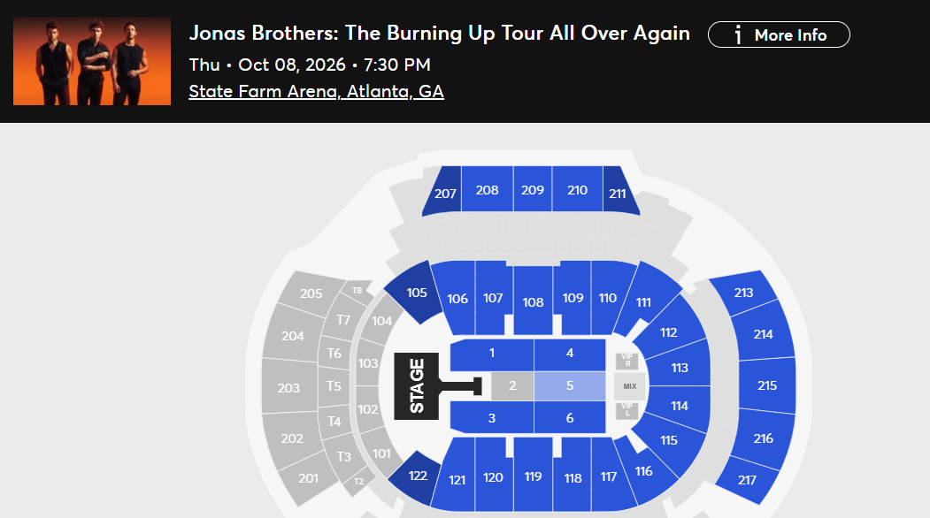
Guess the category?
1
2
3
4

Slide 12

Guess the category?
1
2
3
4

Slide 13
People Processing | Possession processing | Mental stimulus processing | Information processing
Services directed at people bodies | Services directed at physical possessions | Services directed at people’s minds | Services directed at intangible assets
Production and Consumption simultaneously Customer cooperation Operations and environment are crucial | Production and Consumption may not happen simultaneously Customer may not be involved or involved to a lesser degree | Service can be inventoried Consumers may/ may not be physically present | Similar to mental stimulus processing
Haircut, Nail salon, Healthcare | Elevator repair Laundry | Education Advertising Youtube | Legal services Banking Accounting Market Research

Slide 14
Defining Services
    Services are deeds, processes, and performances provided, coproduced or cocreated by an entity or person for and/or with another entity or person.
Notes:
ok

Slide 15
One more classification..
Classification 3
    Service industries and companies: where the core product is a service. Ex: financial services, hospitality.
    Service as a product: intangible product offerings that customers value and pay for in the marketplace. Ex: maintenance service by Michelin (tyre maker), gift wrapping services.
    Customer service: service provided in support of a company’s core products. Ex: service provided with technology purchase.
    Derived service: proposes that the value derived from physical goods is really the service provided by the good, not the good itself. Ex: computers provide information and data manipulation services, razor proving barbering service.
Notes:
ok

Slide 16
    Service Innovations in goods space (Hybrid offerings) – (Extension of Point 2 from the last slide)
Goods
Service
Goods
Service

Slide 17
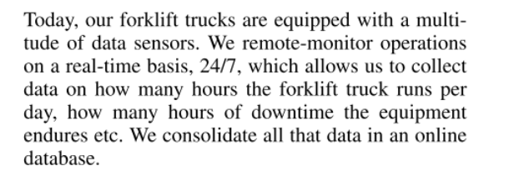
Examples of service innovations in goods space
    A truck manufacturer moving into the maintenance business

Slide 18
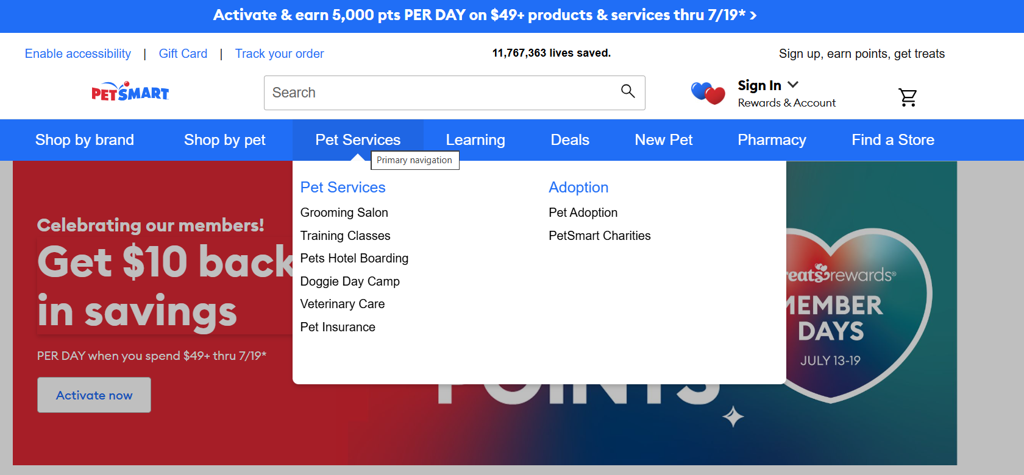
Examples of service innovations in goods space
    A retailer moving into the service business

Slide 19

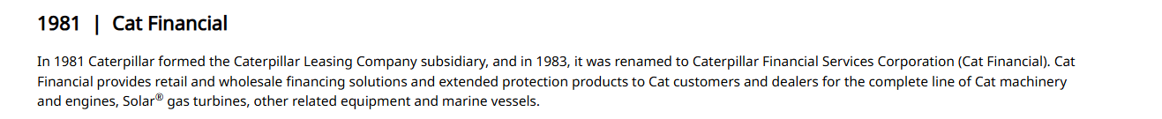
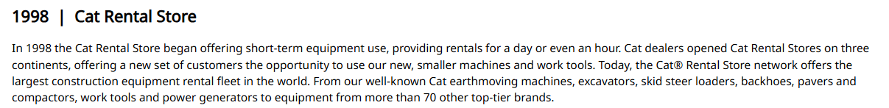

Slide 20
Services characteristics

Slide 21
Differentiating services from goods
Goods | Services | Resulting Implications
Tangible | Intangible | Services cannot be inventoried. Services cannot be easily patented. Services cannot be readily displayed or communicated. Pricing is difficult.
Standardized | Heterogeneous | Service delivery and customer satisfaction depend on employee and customer actions. Service quality depends on many uncontrollable factors. There is no sure knowledge that the service delivered matches what was planned and promoted.

Slide 22
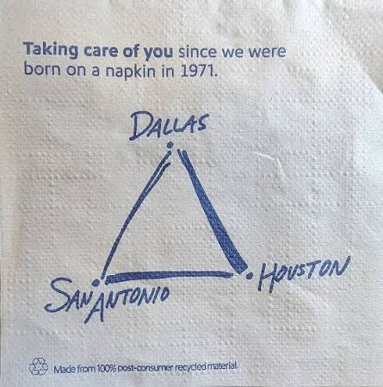
Any guesses?
An evidence of tangibility
  Physical evidence
  Brand history
  Reputation

Slide 23
Differentiating services from goods
Goods | Services | Resulting Implications
Production separate from consumption | Simultaneous production and consumption | Customers participate in and affect the transaction. Customers affect each other. Employees affect the service outcome. Mass production is difficult.
Nonperishable | Perishable | It is difficult to synchronize supply and demand of services. Services cannot be returned and sold. Services for any given time-period cannot be sold or delivered at a later date.
Notes:
Customers are present when service is being produced (dining, air travel etc.) taking part as co-creators of service. Customers may also interact with each other affecting their experience. Inventory and demand forecasting is difficult. Requires marketers to have a strong recovery strategy in case things go wrong.

Slide 24


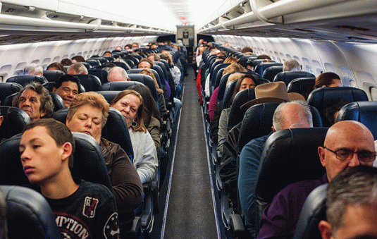
Simultaneous Production and Consumption
Notes:
Customers are present when service is being produced (dining, air travel etc.) taking part as co-creators of service. Customers may also interact with each other affecting their experience.

Slide 25
Perishability
Services cannot be stored, saved, returned, or resold once they have been used.
Notes:
Inventory and demand forecasting is difficult. Requires marketers to have a strong recovery strategy in case things go wrong.

Slide 26
Expanded Marketing Mix (the 7Ps)
Product: physical good, packaging, warranties, etc.
Place: channel type(s), locations, storage, etc.
Promotion: salespeople, training, incentives, advertising, etc.
Price: price level, terms, discounts, etc.
People: employees and customers.
Physical Evidence: facility design, business cards, signage, etc.
Process: flow of activities, number of steps, customer involvement.
Notes:
Because services are intangible, customers are often looking for any tangible cue to help them understand the nature of the service experience.

Slide 27
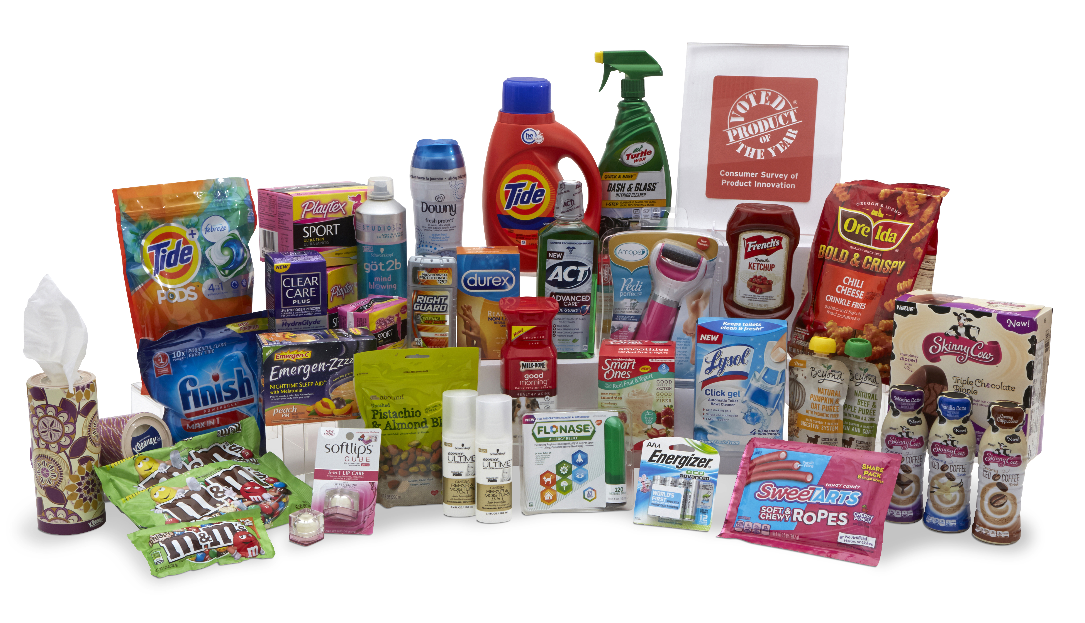
The 4Ps
Source: NBC News

Slide 28
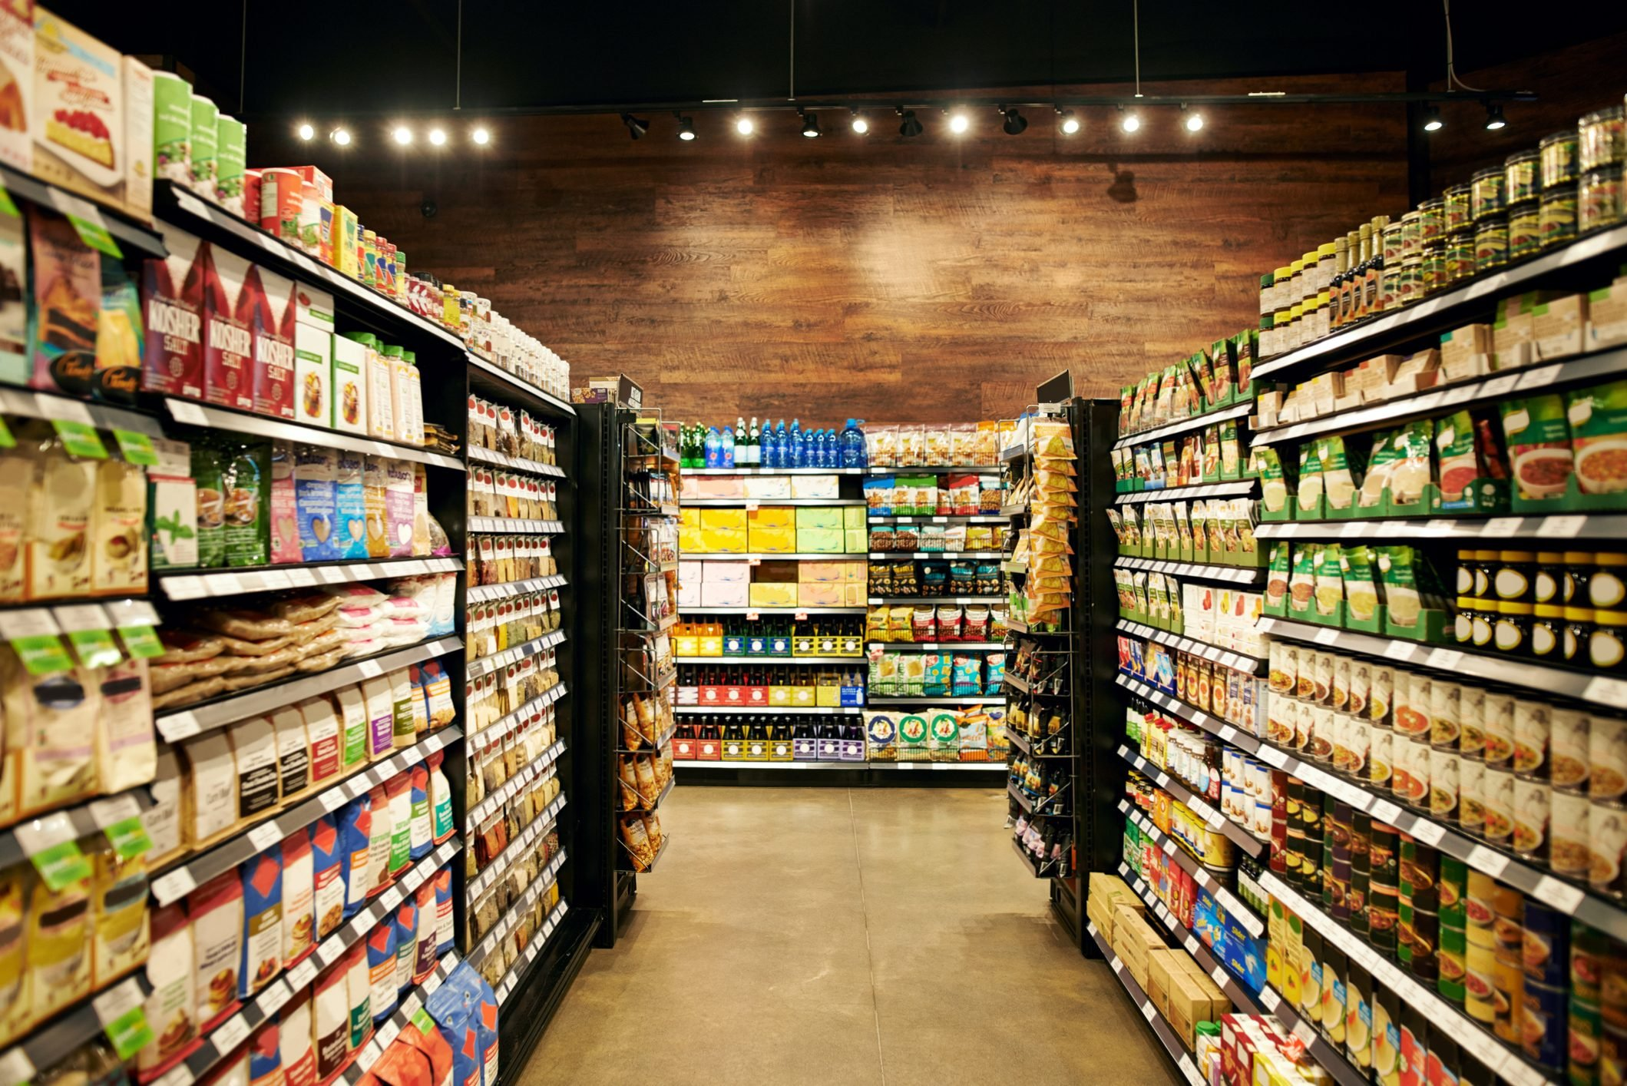
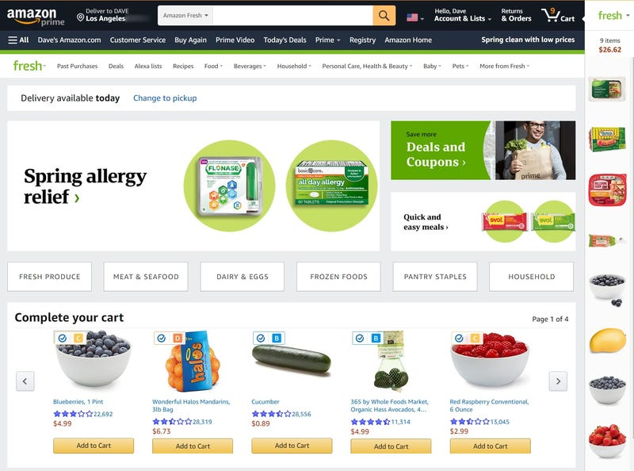
The 4Ps
Source: Supermarket News
Source: Business Insider

Slide 29
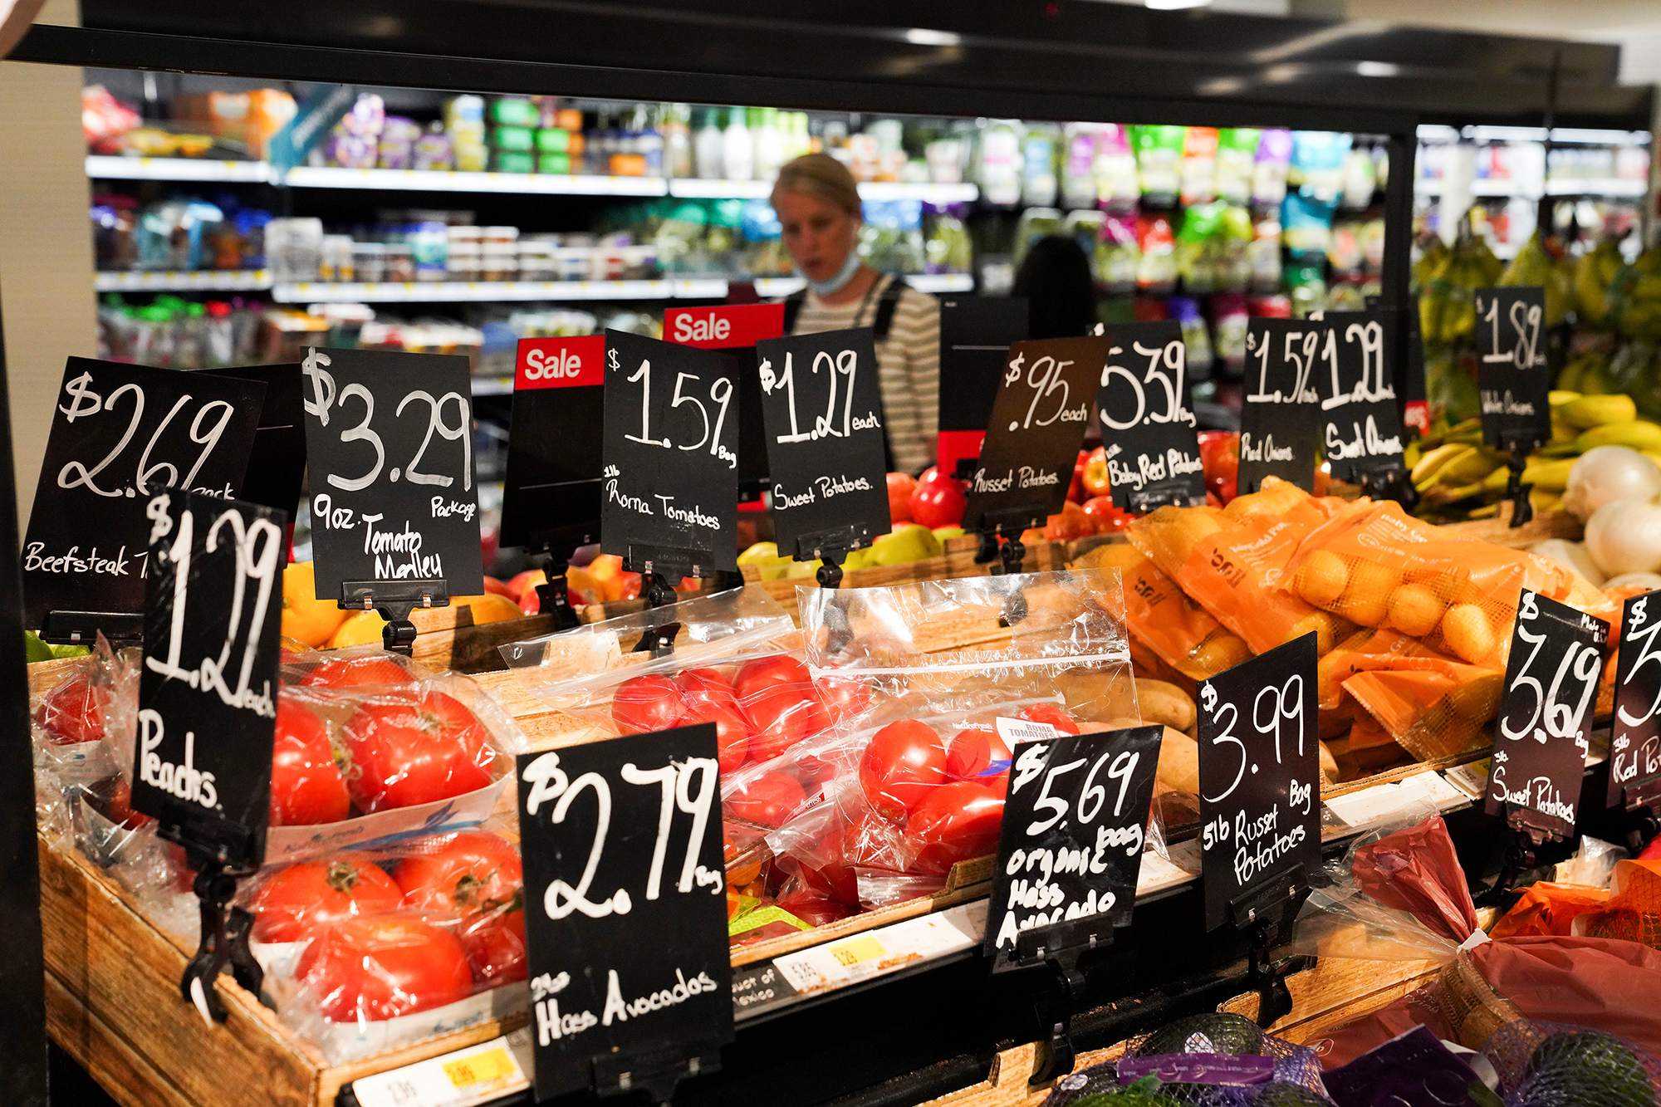
The 4Ps
Source: NY Post

Slide 30
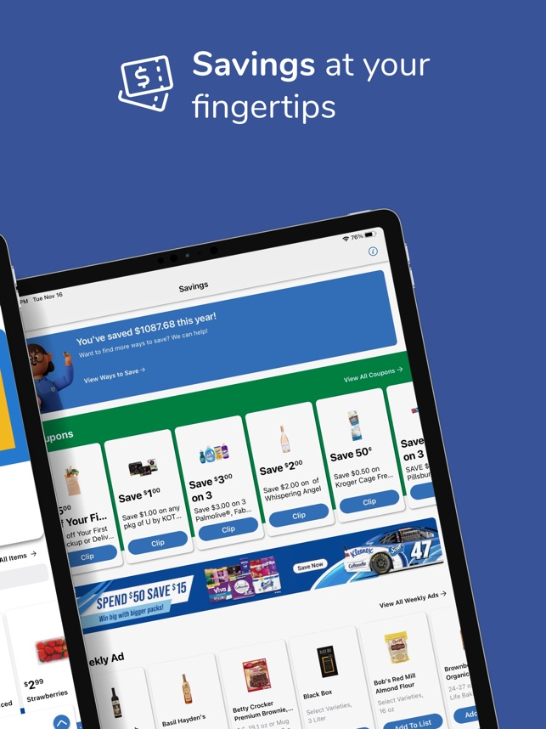
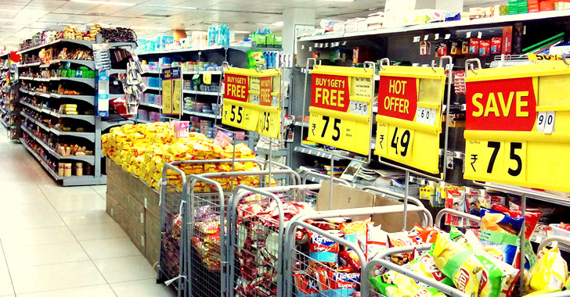
The 4Ps
Source: GoFrugal
Source: Kroger

Slide 31

People
All human actors who play a part in service delivery and thus influences the buyers’ perceptions.
Employees: attitudes and behaviors, dress, appearance, body language – all can influence the customer’s behavior.
Customers: can also influence customer behavior – how do you feel when someone is yelling at / praising an employee?
Source: Inside Retail Asia
Notes:
For some services like consulting, counseling, teaching etc. the provider is the service. Customers can also influence service delivery, affecting service quality and their own satisfaction. Customers can also influence outcomes for other customers, e.g., in a theater.

Slide 32
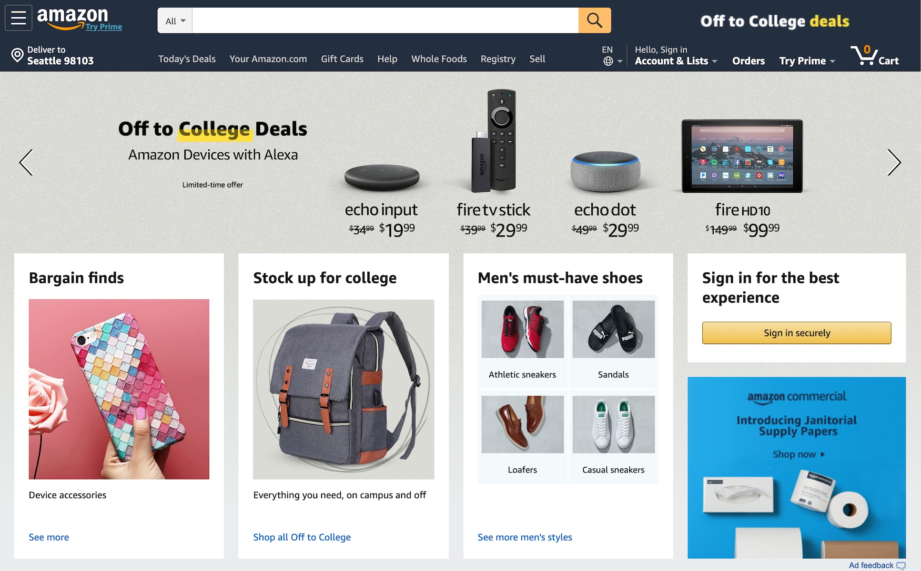
Physical Evidence
The physical and virtual environment in which the service is delivered and where the customer and firm interact.
This includes tangible component that facilitate performance or communication of the service.
When consumers have little to judge the actual quality of service, they will rely on such cues.
Source: Version Museum
Notes:
Physical evidence: brochures, letterheads, signage, equipment, facility where service is offered
Virtual evidence: website, VR interfaces, mobile applications

Slide 33
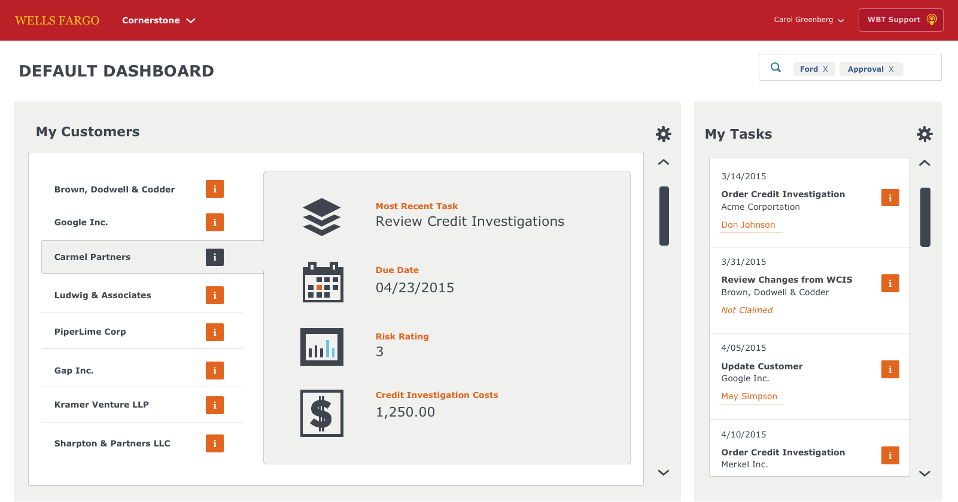
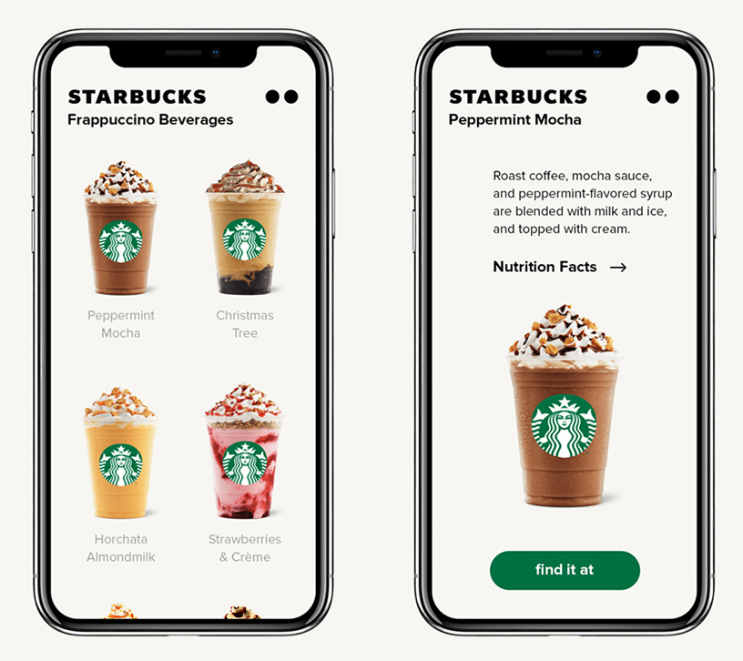
Process
The service delivery and operating systems.
Firms can provide either a higher standardized production-line approach or a flexible and customizable approach.
Source: Carol-Greenberg
Source: Starbucks

Slide 34
Summary
We presented a broad definition, classifications, and key characteristics of services.
We identified the importance of tangibility vs. intangibility, simultaneous production-consumption.
We discussed the 7 Ps of Services Marketing.

